Slide 1

Real Estate Corp – House Price estimates and predictions
Date: 9/26/21
Presenter: Chris Chergi

Slide 2
Losing potential customers due to bad reputation in house prices.
!
Problem
Client sells house lower than actual appraisal or purchases a new house higher than actual appraisal because of bad estimate.
Majority of our clients learn of our business via word of mouth. If our current clients feels they were did not get the best deal then they will not recommend us to friends and family.

Slide 3
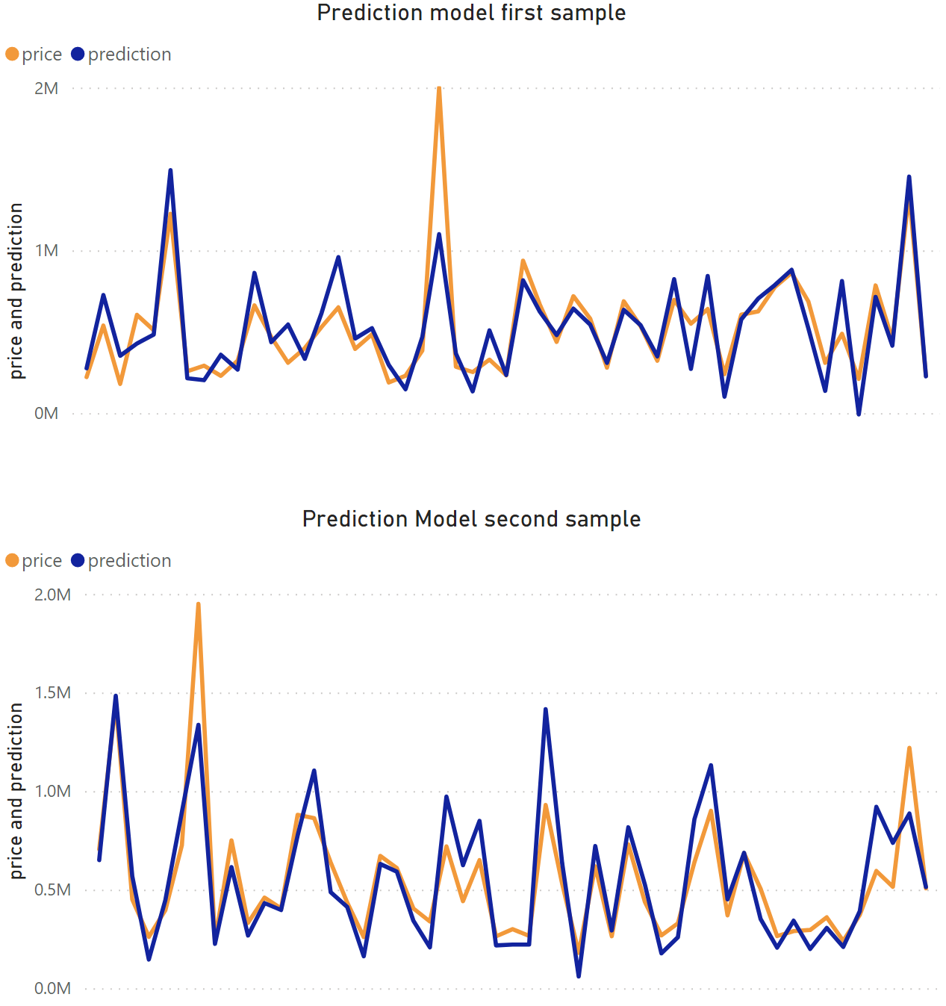
Creating a prediction model to generate an accurate house price based off key data.
Key Insights
By creating a prediction model, we can compare past sales with the prediction model.
Narrowed down which factors had a high correlation to price. Square footage has a correlation of .7 and grade has a correlation of .67.
Running a regression model showed a R-squared value of .692 and the largest p value is a .088.
Source: Southern Water Corp Statistical Records

Slide 4
Approached the data first by descriptive statistics, then moved to inferential statistics to create our prediction model.
Can a statistical model be made to accurately predict house prices to increase client sales by 10% by the end of the year?
Descriptive statistics:
Look at IQR of house prices
Run scatter plots of price vs house descriptors
Look at price vs locations.
Inferential statistics:
Run a correlation heat map of all descriptors
Run a regression model
Create prediction model

Slide 5
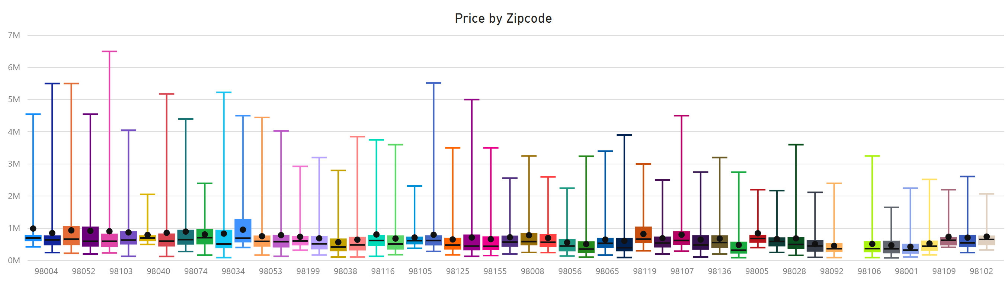
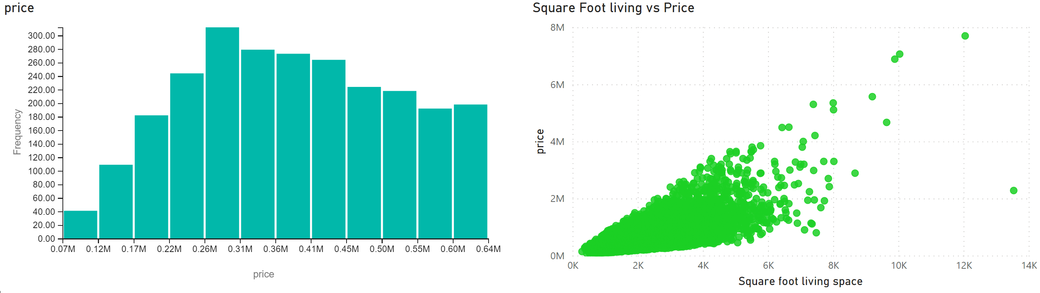
Majority of house prices are between 200K and 600K. Location is not as a big a role as thought but clear correlation with living space.
Key Insights
Majority of house prices are under $640,000
Not a large difference between house prices by zip code
Correlation appears with price vs square foot

Slide 6
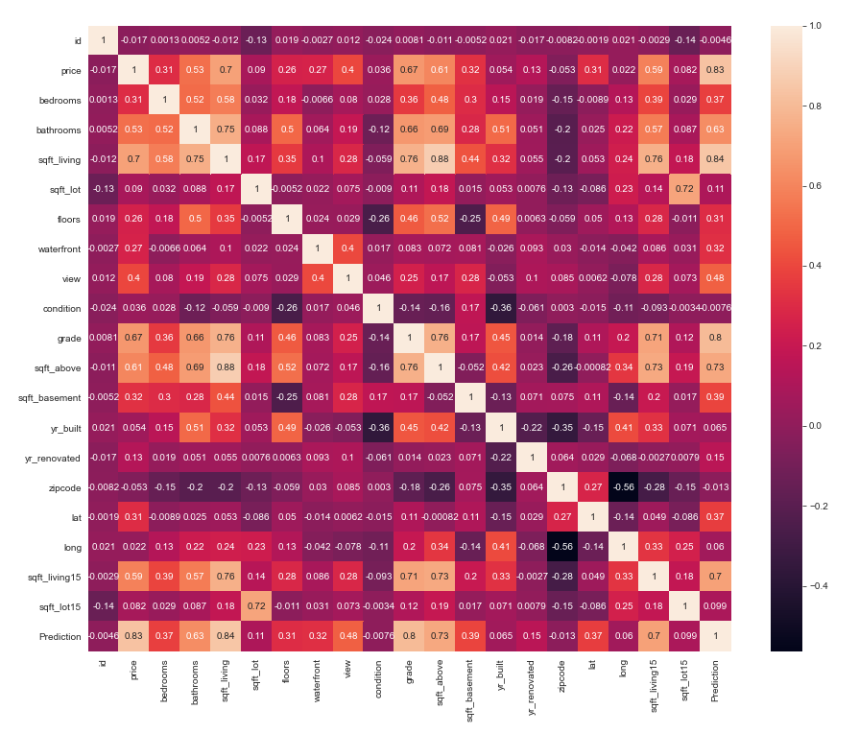
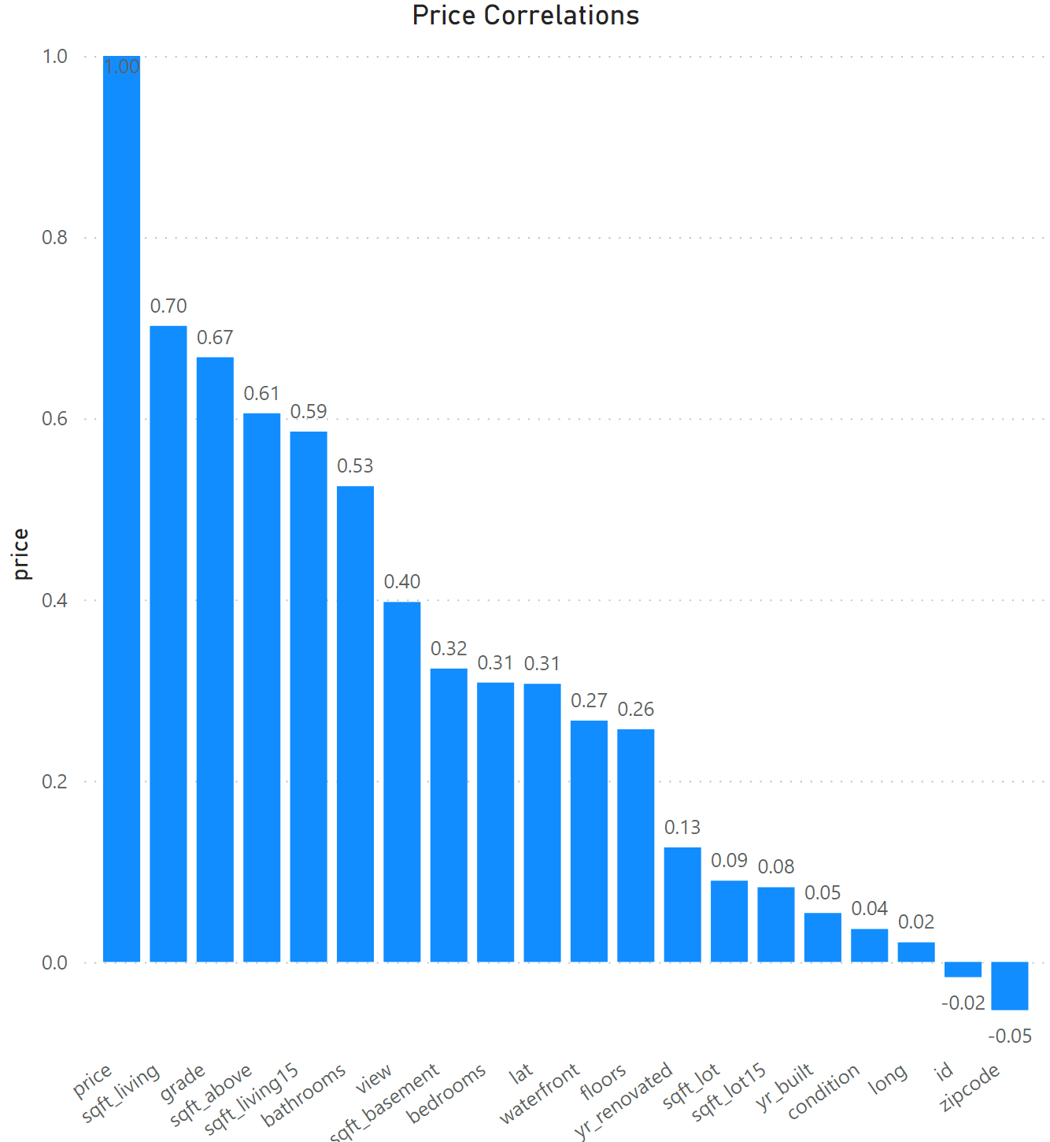
Price has a strong correlation with square footage of house and grade. Pearson regression model has a R-squared value of .658
Key Insights
Square footage high correlation
Zip code has no correlation
Regression model:
R-Squared: .658

Slide 7
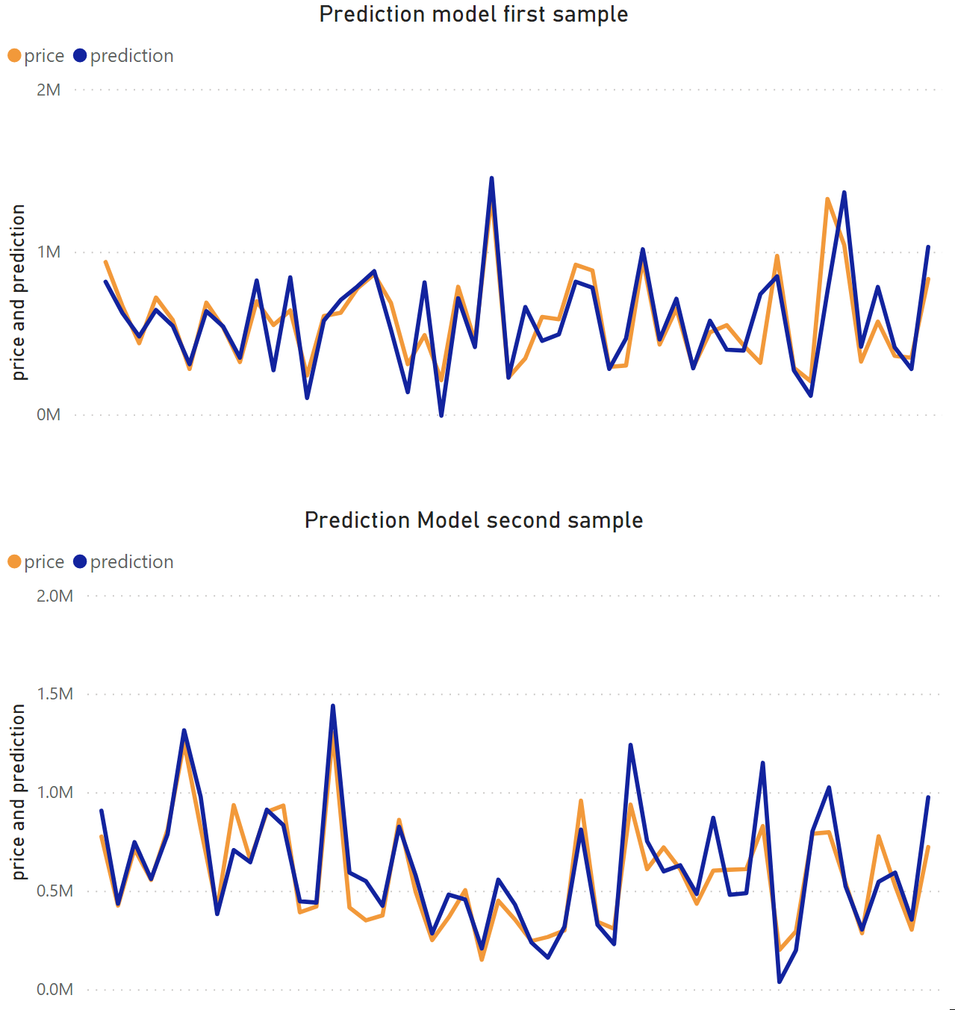
Summary. A prediction model can be made and follows price very well.
Key Insights
Majority of houses sold under $600,000
Square footage and grade had the highest correlation to price
SQFT has a .7 correlation while grade has a .67.
R-Squared after running regression model is .658
List of descriptors for prediction model:
Sqft living, grade,
Sqft_above, bathrooms,
View, sqft_living15,
Sqft_basement, floors,
Waterfront, lat

